Slide 1
Completely relying on on-board sensors – Adaptive Cruise Control
Vinay Sawant

Slide 2
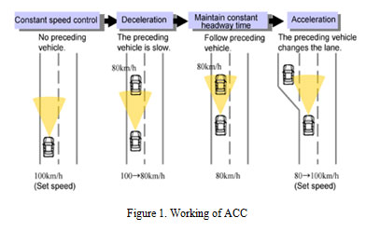
Goal
In case of failure of communication between the robots, the individual robot should rely on on-board sensors to navigate in the environment.
Example: Adaptive Cruise Control
Notes:
Figure 1 : https://biomedpharmajournal.org/vol8no1/fully-automated-cruise-control-system-using-ultrasonic-sensor/

Slide 3
Approach
Using ultrasonic based obstacle detection, increase/ decrease speed of the robot.
The robot will also brake without collision.
Future work will include combine use of other sensors like camera along with ultrasonic sensors.

Slide 4
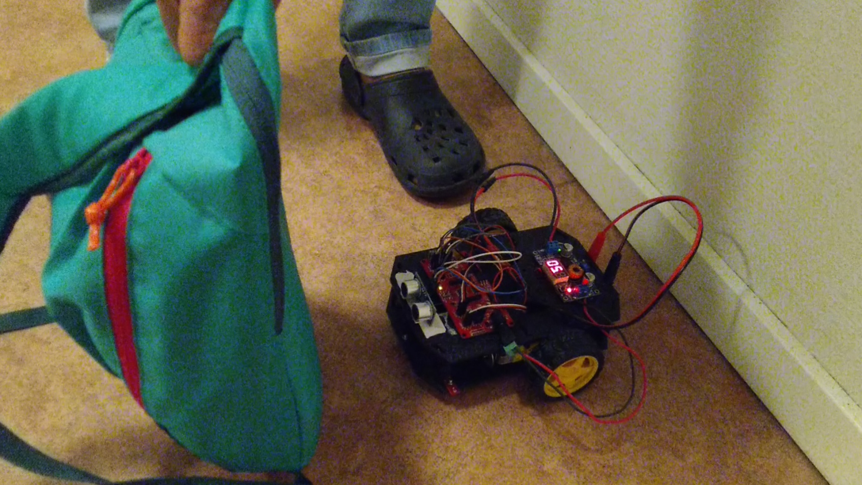
Result – Maintaining safe distance

Slide 5
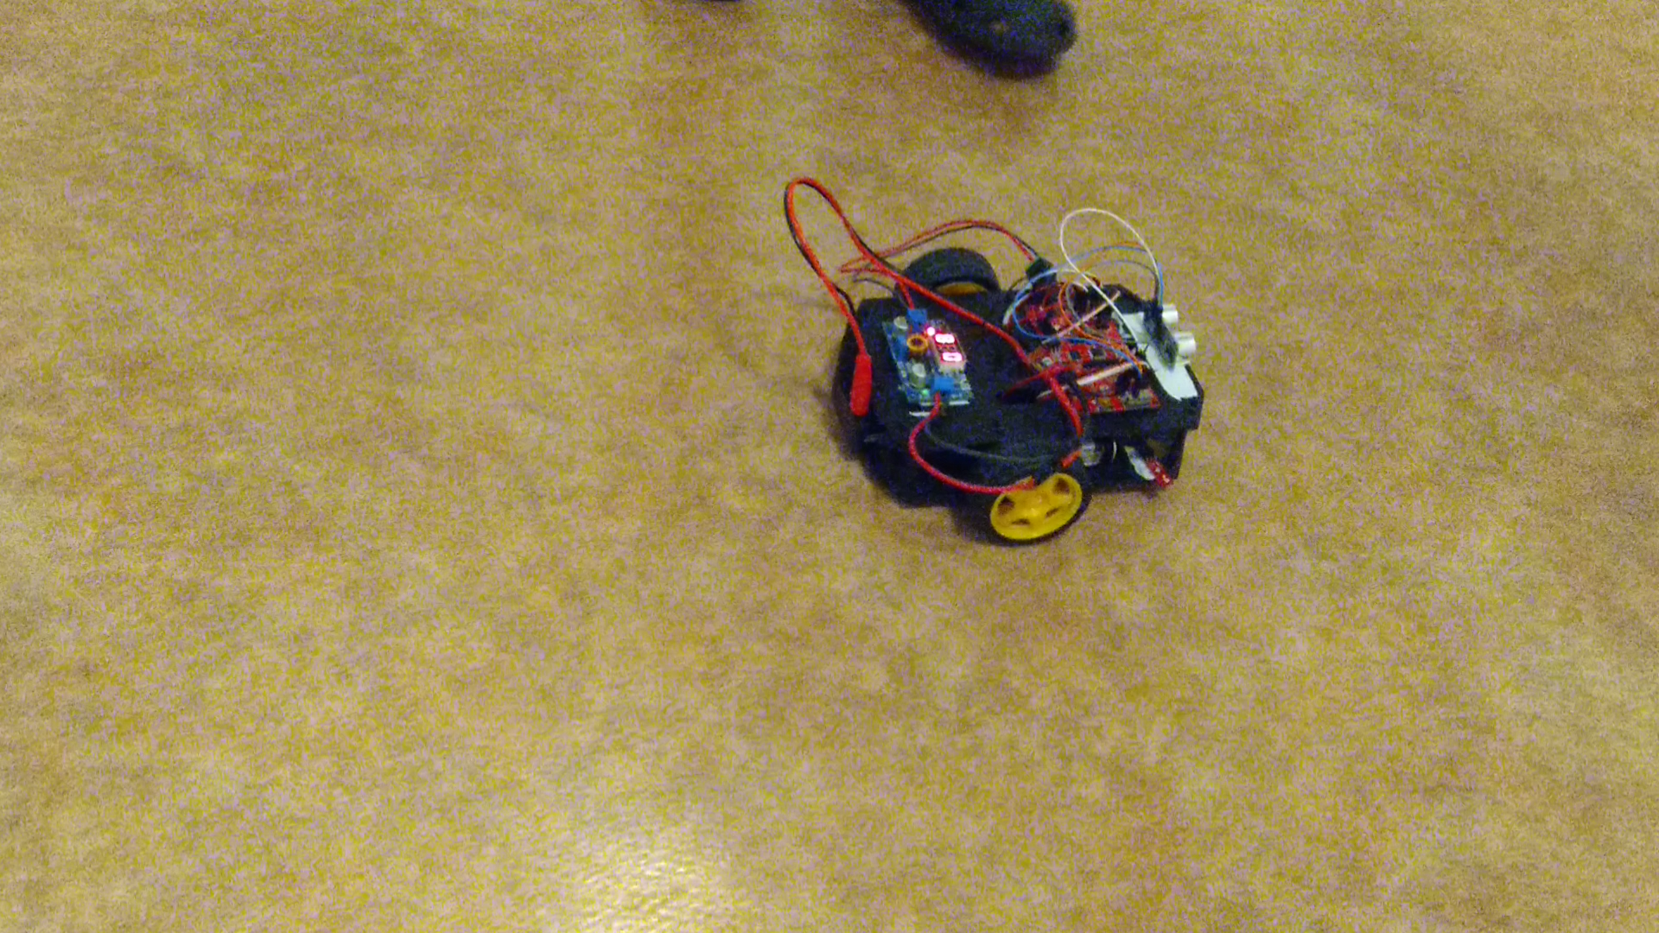
Result – Accelerate/Decelerate

Slide 6
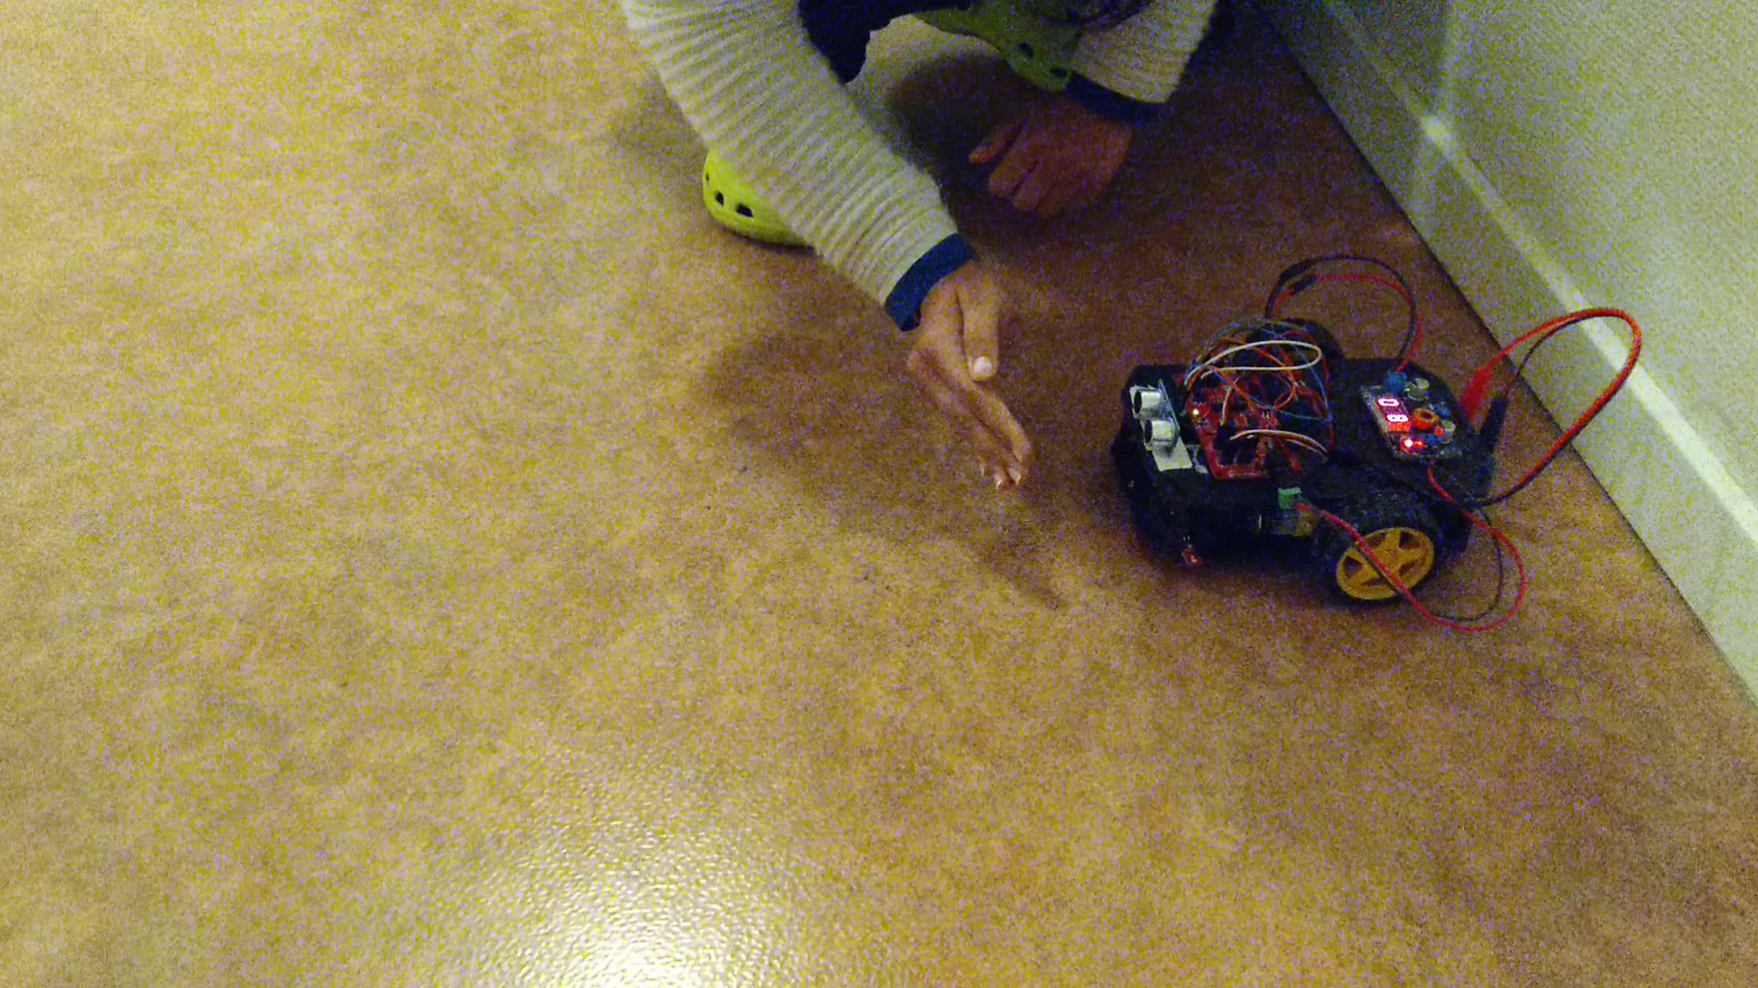
Result – Avoiding Collision

Slide 7
Thank you!

